Slide 1

Operating Model
Model Space, Range & Display Hardware
Production, UAT/DR & Development Platforms
John Cowper
January 07 v0.1
Notes:
1

Slide 2
Assumptions
Architecture assumes that all hardware will be virtualised (Wintel and AIX)
  Wintel platform to use VMWare
  AIX platform uses internal capability
5 Hardware instances for
  Production (1 environment) US & Turkey (2)
  UAT/DR (/Training?) (2 (/3?) environments) US & Turkey (2)
  Test, Integration Test, Patch (3 environments) HSC (1)
Model needs to be amended for local conditions:
  Resilience (assumes DR capability)
  Clustering (assumes no clustering)
  Storage: SAN/Local Disc (assumes SAN)
  Backup (assumes full production standards)
  Capacity (assumes UK volumes)
No recognition is made of the Integration requirements (eg Ab Initio, Biztalk)
  These are already established and available
Expectation that UAT platform will ultimately be used as DR platform

Slide 3
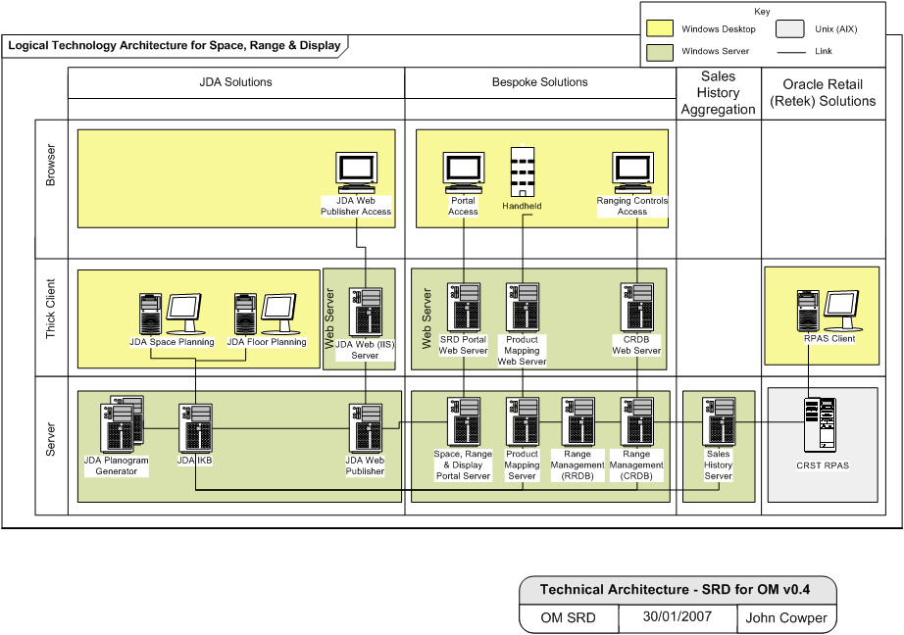
Technical Infrastructure Requirements for Space, Range & Display: Production

Slide 4
Technical Infrastructure Requirements for Space, Range & Display: UAT

Slide 5
Technical Infrastructure Requirements for Space, Range & Display: Test/Int. Test/Patch

Slide 6
Hardware
AIX Server
  IBM p5 9131-52a
Logical Windows Servers
  Dell/HP/IBM Single, Dual and Quad Processor – see following list
Windows Thick Client Desktops
  Dell/HP/IBM Single Processor – 1 per user
Windows Thin Client Desktops
  Dell/HP/IBM Single Processor – 1 per user

Slide 7
Hardware – AIX Database Server
RPAS Server Production/UAT
  IBM p5 9131-52a – 2 per Country (Production & DR/UAT)
  Virtualised
  4 CPU
  8GB RAM
  500GB SAN
  OS certification: RPAS 11.2 is certified for AIX 5.3 (RPAS 11.1 is only certified for AIX 5.1)
  UAT server supports training
RPAS Server Test/Integration Test/Patch
  As above – same spec
  1 per Country
  3 environments
    Test – 25%
    Patch – 25%
    Integration Test – 50%

Slide 8
Hardware: Logical Windows App/Database Servers
Device | No of Processors | RAM | SAN | OS | Database (MS SQL)
JDA IKB | 4 | 2GB | 200GB | W2K3 | W2K5
JDA Planogram Generator | 1 | 1GB | 100GB | W2K3 | -
JDA Web Publisher | 1 | 1GB | 100GB | W2K3 | -
Sales History Server | 4 | 4GB | 500GB | W2K3 | W2K5
Product Mapping Server | 4 | 4GB | 200GB | W2K3 | W2K5
Retail Range Database (RRDB) | 2 | 4GB | 1TB | W2K | W2K
Commercial Range Database (CRDB) | 2 | 4GB | 1TB | W2K? | W2K
SRD Portal Server | 2 | 4GB | 200GB | W2K3 | -

Slide 9
Hardware: Logical Windows Web Servers
Device | No of Web Servers | No of Processors | RAM | SAN | OS
JDA Web Server | 1 | 1 | 1GB | 100GB | W2K3
Product Mapping Web Server | 4 | 1 | 4GB | 100GB | W2K3
CRDB Web Server | 1 | 2 | 4GB | 100GB | W2K3
SRD Portal Web Server | 4 | 1 | 4GB | 100GB | W2K3
Hardware load balancers required to support Product Mapping and SRD Portal

Slide 10
Hardware – Windows Database Servers
IKB Database Server: Production and UAT/DR
  2 per Country (Production and UAT/DR)
  Virtualised
  Processor Speed: US/Turkey
    P4 Dual 3Ghz Processor (Acceptable)
    P4 Quad 2+Ghz Processor (Recommended)
  RAM
    2 GB
  Disk Capacity
    100 GB for Data (Acceptable)
    200GB for Data (Recommended)
  Windows 2003 Server
  SQLServer 2005 Standard Edition
  .NET 2.0 (2.1?)

Slide 11
Hardware – Windows Database Servers
IKB Database Server Test/Integration Test/Patch
  As above – same spec
  1 per Country: HSC
  Virtualised
  3 environments
    Test – 25%
    Patch – 25%
    Integration Test – 50%

Slide 12
Hardware – Windows Database Servers
Product Mapping Database Server: Production and UAT/DR
  2 per Country (Production and UAT/DR)
  Virtualised
  Processor Speed:
    P4 Quad 2+Ghz Processor
  RAM
    4 GB
  Disk Capacity
    200GB for Data (Recommended)
  Windows 2003 Server
  SQLServer 2005 Standard Edition
  .NET 2.0 (2.1?)
Product Mapping Database Server: Test/Integration Test/Patch
  1 per country
  Virtualised

Slide 13
Hardware – Windows Database Servers
Sales History Database Server: Production and UAT/DR
  2 per Country (Production and UAT/DR)
  Virtualised
  Processor Speed:
    P4 Quad 2+Ghz Processor
  RAM
    4 GB
  Disk Capacity
    200GB for Data
  Windows 2003 Server
  SQLServer 2005 Standard Edition
  .NET 2.0 (2.1?)

Slide 14
Hardware – Windows Database Servers
Sales History Database Server: Test/Int. Test/Patch
  1 per Country
  Virtualised
  Spec as above
  Partition into 3 environments
    Test – 25%
    Patch – 25%
    Integration Test – 50%

Slide 15
Hardware – Windows Batch Servers
Planogram Batch Processing Server: Production and UAT/DR
  2 per Country (Production and UAT/DR)
  Processor Speed: US & Turkey
    P4 Single 2Ghz Processor or better
  RAM
    1 GB
  Disk Capacity
    50 GB for data (Acceptable)
    100GB for data (Recommended)
  Windows 2003 Server R2, 2000 Advanced Server (SP4 or higher), or 2000 Server (SP4 or higher)
  Microsoft Internet Information Server 5.0 or 6.0

Slide 16
Hardware – Windows Batch Servers
Planogram Batch Processing Server: Test/Int. Test/Patch
  1 per Country
  Virtualised
  Spec as above
  Partition into 3 environments
    Test – 25%
    Patch – 25%
    Integration Test – 50%

Slide 17
Hardware – Windows Publishing Servers
JDA Publishing Server – 2 per Country
  2 per Country (Production and UAT/DR)
  Processor Speed: US & Turkey
    P4 Single 2Ghz Processor or better
  RAM
    1 GB
  Disk Capacity
    50 GB for data (Acceptable)
    100 GB for data (Recommended)
  Windows 2003 Server R2, 2000 Advanced Server (SP4 or higher), or 2000 Server (SP4 or higher)
  Note: Web Publisher does not use the BITS, FTP, FrontPage, Internet Printing, NNTP, or SMTP components of Internet Information Server. These components can be omitted or removed, as needed.
  Internet Explorer 6.0
  Space Planning, for generating planogram data, as needed
  Floor Planning, for generating floorplan data, as needed (Web Publishing only)
  JAWS PDF Creator, for generating PDF files (Web Publishing only).
  Intactix Knowledge Base Client components, for connecting to the Intactix database and configuring Web Publisher
  MDAC version 2.7 or higher.

Slide 18
Hardware – Windows Publishing Servers
JDA Publishing Server – Test/Int. Test/Patch
  1 per Country
  Virtualised
  Spec as above
  Partition into 3 environments
    Test – 25%
    Patch – 25%
    Integration Test – 50%

Slide 19
Hardware – Windows Publishing Servers
Space, Range and Display Portal Publishing Server: Production and UAT/DR
  2 per Country (Production and UAT/DR)
  Processor Speed: US & Turkey
    2 x P4 Single 2Ghz Processor or better
  RAM
    4 GB
  Disk Capacity
    200 GB for data
  Windows 2003 Server
  Internet Explorer 6.0

Slide 20
Hardware – Web Servers
JDA Web Server – 1 per Country
  Processor Speed: US & Turkey
    P4 Single 2Ghz Processor or better
  RAM
    1 GB
  Disk Capacity
    50 GB for data (Acceptable)
    100 GB for data (Recommended)
  Windows 2003 Server R2, 2000 Advanced Server (SP4 or higher), or 2000 Server (SP4 or higher)
  Internet Explorer 6.0

Slide 21
Hardware – Web Servers
Space, Range and Display Portal Publishing Server: Production and UAT/DR
  4 per country (Production and UAT/DR)
  Processor Speed: US & Turkey
    2 x P4 Single 2Ghz Processor or better
  RAM
    4 GB
  Disk Capacity
    100 GB for data
  Windows 2003 Server
  Internet Explorer 6.0

Slide 22
Hardware – Web Servers
Space, Range and Display Portal Web Server: Test/Int. Test/Patch
  4 per country (Production and UAT/DR)
  Processor Speed: US & Turkey
    2 x P4 Single 2Ghz Processor or better
  RAM
    4 GB
  Disk Capacity
    100 GB for data
  Windows 2003 Server
  Internet Explorer 6.0

Slide 23
Hardware – Windows Desktop
RPAS
Thick Client Desktop – 1 per user
Awaiting confirmation

Slide 24
Hardware – Windows Desktop
JDA Space Planning and Floor Planning
Thick Client Desktop – 1 per user
  Processor Speed: US & Turkey
    P4 Single 2Ghz Processor or better
  RAM
    512 MB or better
  Disk Capacity
    40 GB or better
  Internet Explorer 6.0, to perform the installation
  Windows 2000 (SP4 or higher), XP Professional (SP2 or higher), or XP Tablet (SP2 or higher) for client applications
  Windows 2000 or 2000 Server (SP3 or higher), 2000 Advanced Server, or 2003 Server R2, or for machines running with a SQL or Oracle database. In addition, UNIX on AIX 5.2 or 5.3, SUN 8.0, or HP 11.0 for Oracle databases.
  SQL Server 2000 (SP4) or 2005, Microsoft Data Engine (SP3) or SQL Express, or Oracle 9i (9.2.07) or 10g (10.2.0.1) for the Intactix database and administrator machines.
  JDA Portfolio 2006.2 requires .NET Framework 1.1, but SQL Server 2005 requires .NET Framework 2.0.
  MDAC version 2.7 or higher.

Slide 25
Hardware – Windows Desktop
Thin Client Desktop – 1 per user
  Processor Speed: US & Turkey
    Single 800Mhz Processor or better
  RAM
    256 MB or better
  Disk Capacity
    20 GB or better

